Slide 1

Selection & Ordering
Algorithms
CE-1103 Algorithms and Data Structures

Slide 2
Disclaimer / Descargo de Responsabilidad
Esta presentación corresponde a una guía usada por el profesor durante las clases. La misma ha sido modificada para ser utilizado en el modelo de cursos asistidos por tecnología. No es una versión final, por lo que la misma podría requerir todavía hacer algunos ajustes. Para aspectos de evaluación esta presentación es solo una guía, por lo que el estudiante debe profundizar con el material de lectura asignado y lo discutido en clases para aspectos de evaluación.
This presentation corresponds to a guide material used by the professor during classes. It has been modified to be used in the model of technology-assisted courses. It is not a final version, so it may still require some adjustments. For evaluation aspects, this presentation is only a guide, so the student should delve with the assigned reading material and what has been discussed in class.

Slide 3

Before we begin...
What is an algorithm?
How can we represent an algorithm?
How can we measure the efficiency of an algorithm?

Slide 4
What is an Algorithm?
An algorithm is “a finite set of precise instructions for performing a computation or for solving a problem
An algorithm is “a well-ordered collection of unambiguous and effectively computable operations that when executed produces a result and halts in a finite amount of time”

Slide 5
Characteristics of an Algorithm
Finiteness: terminate after a finite number of steps
Definiteness: each step is precisely defined. There is no ambiguity.
Has a well defined input
Input
?
Output

Slide 6
Characteristics of an Algorithm
Has an output
Effectiveness: accomplish its purpose
Deterministic/Uniqueness
Results of each step are uniquely defined by the input and the result of the preceding steps.
Input
?
Output

Slide 7

What is algorithm analysis?
Algorithm analysis is a method for estimating the resource consumption of an algorithm

Slide 8

Why analyze an algorithm?
Discover the characteristics of an algorithm in order to evaluate its suitability for various applications.
Compare an algorithm with other for the same application/purpose

Slide 9
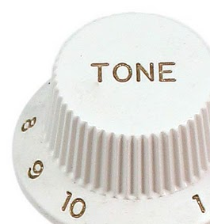
Why analyze an algorithm?
Classify problems and algorithms by difficulty
Predict performance, compare algorithms, tune parameters
Better understand and improve implementations and algorithms

Slide 10
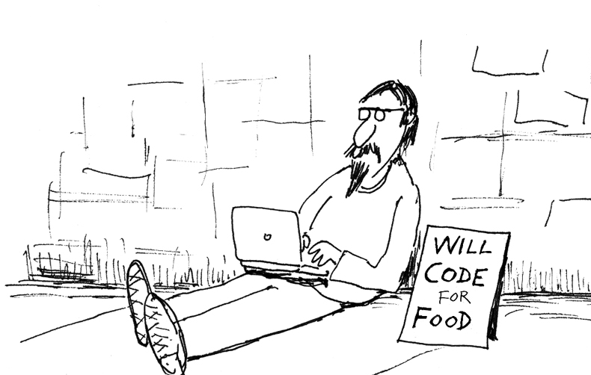
Factors Affecting Run Time
Computer System (CPU, Memory, Disk)
Compiler
Programing Language
Operating System

Slide 11
Factors Affecting Run Time
Developer
Size of input
Current applications running on the computer.

Slide 12

Before we continue...
What should we use as a measure of how “good” an algorithm is?
How should we compare two algorithms with each other?

Slide 13
The characteristics of interest
Time (CPU)
How long an implementation of a particular algorithm will run on a particular computer
Space (Disk/Memory)
How much space it will require
It is not the best option
It is not the best option

Slide 14

The characteristics of interest
Time (CPU)
How long an implementation of a particular algorithm will run on a particular computer
Space (Disk/Memory)
How much space it will require
It is not the best option
It is not the best option
Is there any other characteristic?

Slide 15
Other Characteristics
Network Bandwidth
Disk space
Peripheral devices
Any resource in the computer

Slide 16
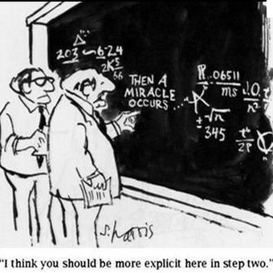
Good Measures, bad Measures
Empirical
Benchmark
Simulational
Simulated data
Test cases
Analytical
Mathematical Model (time & space)

Slide 17
What is the best approach?

Slide 18
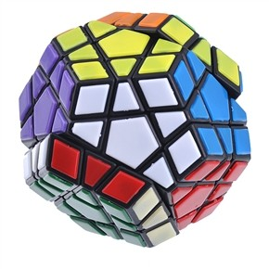
Computational Complexity
Classifies computational problems according to their difficulty
Time Complexity
Space Complexity

Slide 19
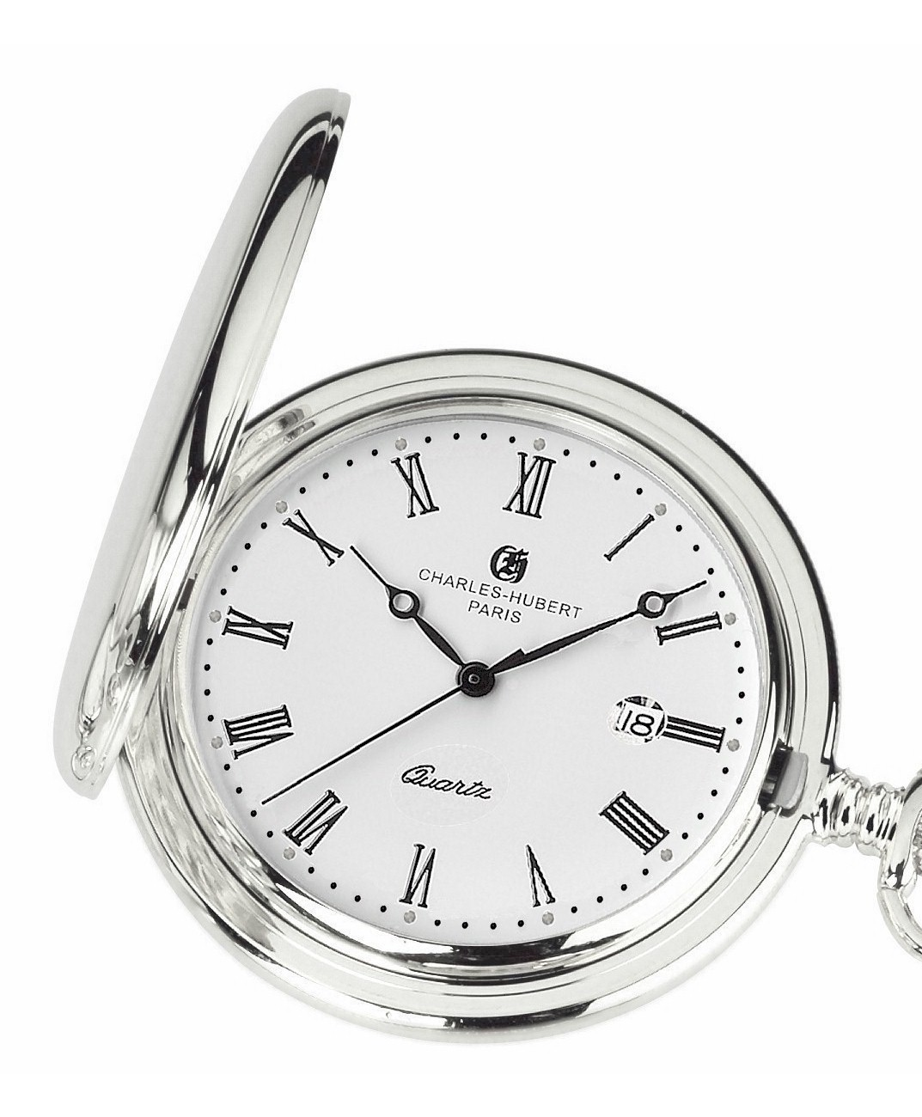
Time Complexity
Classifies the amount of time taken by an algorithm
Represents the algorithm as a function of the size of the input
Focus on dominant operations, the ones which perform more “primitive” operations.

Slide 20

Time Complexity
Time complexity is estimated by counting elementary instructions.
Analyze the growth rate of the function.

Slide 21
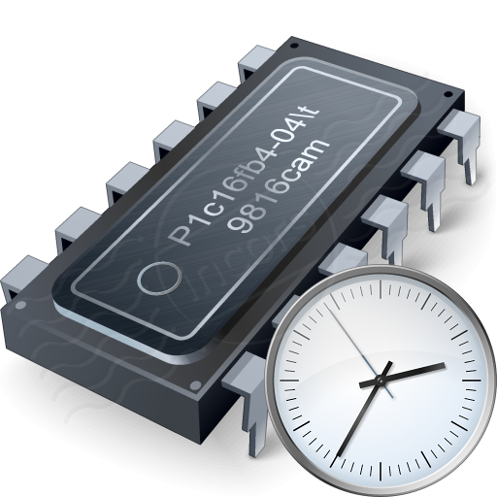
What is time?
Wall clock or real time
CPU time
Number of instructions executed

Slide 22
Clock Speed
Frequency at which the CPU is running
It is measured in hertz or gigahertz
Higher frequency is higher clock rate (amount of clock cycles per time unit)
How many instructions can I execute per clock cycle?

Slide 23
CPU Performance
Cycles per instruction (clock cycles or just clocks)
Instructions per cycle (instruction per clock)
Instruction per second
Elementary Instructions (constant time) vs Composed instructions.

Slide 24
Elementary Instructions
Instructions that always takes the same time and this time is independent of the input size.
We don’t care about how many cycles the instruction needs to be executed
T is a variable which depends on the architecture and hardware, T denotes the time required to execute the instruction.

Slide 25
Constant Time Instructions
Basic Arithmetic Operators (+, -, /, %, ^)
Bitwise operators (<< , >>)
Logical operators (==, !=, and, or, ~ ...)
Jumps (returns values, method calls, ...)
Assignments, access to indexed structures.

Slide 26
Time Complexity Example
01 02 03 04 05 06 07 08 09 10 | boolean search(int arr[], int n, int num){ boolean flag = false; for (int i = 0; i < n; i++){ if (arr[i] == num){ flag = true; break; } } return flag; }

Slide 27
Time Complexity Example
One declaration + One assignment = 2T
01 02 03 04 05 06 07 08 09 10 | boolean search(int arr[], int n, int num){ boolean flag = false; for (int i = 0; i < n; i++){ if (arr[i] == num){ flag = true; break; } } return flag; }

Slide 28
Time Complexity Example
One declaration + One assignment = 2T
One comparison = 1T
One Increment = 1T
01 02 03 04 05 06 07 08 09 10 | boolean search(int arr[], int n, int num){ boolean flag = false; for (int i = 0; i < n; i++){ if (arr[i] == num){ flag = true; break; } } return flag; }

Slide 29
Time Complexity Example
One declaration + One array access = 2T
01 02 03 04 05 06 07 08 09 10 | boolean search(int arr[], int n, int num){ boolean flag = false; for (int i = 0; i < n; i++){ if (arr[i] == num){ flag = true; break; } } return flag; }

Slide 30
Time Complexity Example
01 02 03 04 05 06 07 08 09 10 | boolean search(int arr[], int n, int num){ boolean flag = false; for (int i = 0; i < n; i++){ if (arr[i] == num){ flag = true; break; } } return flag; }
One assignment = 1T

Slide 31
Time Complexity Example
01 02 03 04 05 06 07 08 09 10 | boolean search(int arr[], int n, int num){ boolean flag = false; for (int i = 0; i < n; i++){ if (arr[i] == num){ flag = true; break; } } return flag; }
One jump = 1T

Slide 32
Time Complexity Example
01 02 03 04 05 06 07 08 09 10 | boolean search(int arr[], int n, int num){ boolean flag = false; for (int i = 0; i < n; i++){ if (arr[i] == num){ flag = true; break; } } return flag; }
One jump = 1T

Slide 33
How to calculate complexities Sequence of statements
01 02 03 04 05 06 | Statement_1; Statement_2; … … … Statement_N;
Total time: Time(Stament_1) + Time(Stament_2) + … + Time(Stament_N)

Slide 34
How to calculate complexities If - Then - Else / Switch
01 02 03 04 05 | if (condition) { block of statements 1 } else { block of statements 2 }
Total time: Time(condition) + max(Time(Statement_block_1), Time(Statement_block_2), …, Time((Statement_block_N))

Slide 35
How to calculate complexities Loops
01 02 03 | for (int i = 0; i <= n; i++){ block of statements }
Total time: time(declaration) + time(assignment) + (n+1)(time(comparison_time) + time(increment)) + (n)(time(block of statements)) = 2T + (2NT + 2T) + N(T_Block) = 3NT + N(T_Block) + 4T

Slide 36
Time Complexity Example
01 02 03 04 05 06 07 08 09 10 | boolean search(int arr[], int n, int num){ boolean flag = false; for (int i = 0; i < n; i++){ if (arr[i] == num){ flag = true; break; } } return flag; }
Total time = 7NT + 8T

Slide 37
Best, worst and average
Best case scenario: resource usage at least
Worst case Scenario: resource usage at most
Average case scenario: resource usage on average
Worst
Average
Best

Slide 38
Big-O Notation
Work can be calculated as a function of the size of the input to the algorithm
It is possible to express an approximation of this function using a mathematical notation called order of magnitude or Big-O
Big-O: A notation that expresses computing time (complexity) as the term in the function that increases most rapidly relative to the size of a problem

Slide 39
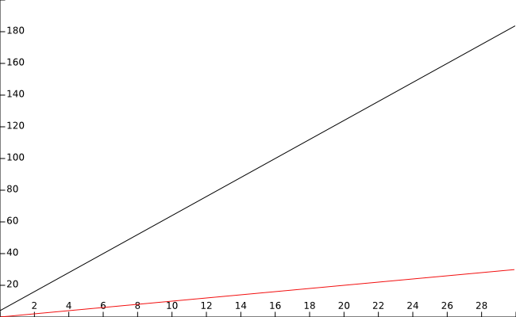
Time Complexity Example
f(N) = 7NT + 8T
f(N) = N

Slide 40
Time Complexity Example
N defines the growth rate
f(N) = 7NT + 8T
f(N) = N

Slide 41
Which term defines the function?
f(n) = 2n³ + 3n² + log₁₀ (n) + 333
n | f(n) | 2n³ | 3n² | log₁₀(n) | 333
1 | 338 | 2 | 3 | 0 | 333
10 | 2634 | 2x10³ | 3x10² | 1 | 333
100 | 2030335 | 2x10⁶ | 3x10⁴ | 2 | 333
1000 | 2003000336 | 2x10⁹ | 3x10⁶ | 3 | 333
10000 | 2000300000337 | 2x10¹² | 3x10⁸ | 4 | 333

Slide 42
Which term defines the function?
O(n³)
f(n) = 2n³ + 3n² + log₁₀ (n) + 333
n | f(n) | 2n³ | 3n² | log₁₀(n) | 333
1 | 338 | 2 | 3 | 0 | 333
10 | 2634 | 2x10³ | 3x10² | 1 | 333
100 | 2030335 | 2x10⁶ | 3x10⁴ | 2 | 333
1000 | 2003000336 | 2x10⁹ | 3x10⁶ | 3 | 333
10000 | 2000300000337 | 2x10¹² | 3x10⁸ | 4 | 333

Slide 43
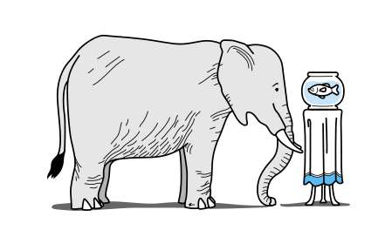

Slide 44
Common Orders of Growth
1 | Constant | Common Problems
log₁₀ N | Logarithmic
N | Linear
N log₁₀ N | Linear Logarithmic
N² | Quadratic
N³ | Qubic
2^{N} | Exponential | Hard Problems
N! | Factorial

Slide 45
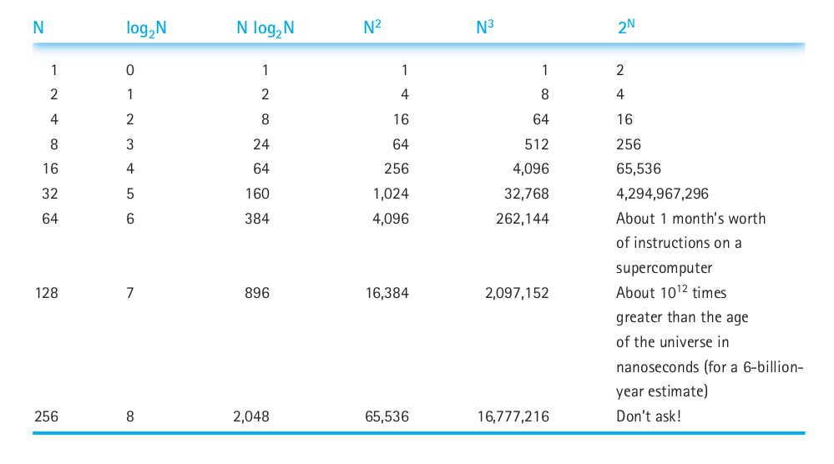
Common Orders of Growth

Slide 46

Sort Algorithms

Slide 47
Sorting Algorithm
Keeping lists of elements in sorted order is important to facilitate searching
There are many algorithms to sort lists
The main goal is to come up with better, more efficient, sorts

Slide 48
Sorting Algorithm
How can we describe efficiency while comparing sorting algorithms?
Pick the central operation for sorting algorithms: the operation that compares two values
Relate the efficiency of each algorithm to the number of elements in the list (N) as a measure

Slide 49
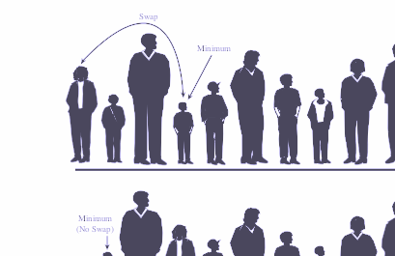
Selection Sort
Sorting algorithm

Slide 50
Selection sort
An example problem
We have a list of names and we are asked to put them in alphabetical order. How do you solve it?

Slide 51
Selection sort
The solution
Find the name that comes first in alphabetical order and write it on a second sheet of paper
Cross the name out on the original list
Continue the cycle until all names on the original list have been crossed out and written onto the second list, which is sorted

Slide 52
Selection sort
Space consideration
Keeping a second list of elements involves using more memory
A slight adjustment involves swapping elements:
As you “cross out” elements of the original list, a free space opens up.
Swap the found element with the “current” position

Slide 53
Selection sort
Pseudocode
01 02 03 04 05 | Set current to the index of first item in the array while more items in unsorted part of array Find the index of the smallest unsorted item Swap the current item with the smallest unsorted one Increment current to shrink unsorted array part

Slide 54
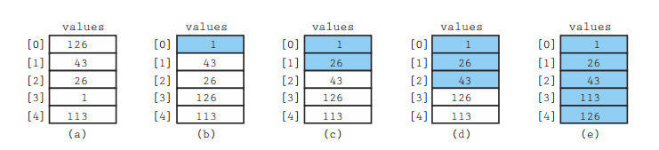
Selection sort
Example

Slide 55
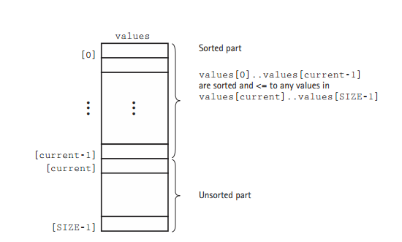
Selection sort
Example

Slide 56
Selection sort
Implementation
01 02 03 04 05 06 07 08 09 | static int minIndex(int start, int end) { int indexOfMin = start; for (int index = start + 1; index <= end; index++){ if (values[index] < values[indexOfMin]){ indexOfMin = index; } } return indexOfMin; }

Slide 57
Selection sort
Implementation
01 02 03 04 05 06 | static void selectSort() { int endIdex = size - 1; for (int current = 0; current < endIndex; current++) { swap(current, minIndex(current, endIndex)); } }

Slide 58
Selection sort
Analyzing the algorithm
In the first call there are N-1 comparisons
Next call is N-2 and so on until only 1 comparison left
01 02 03 04 05 06 07 08 09 | static int minIndex(int start, int end) { int indexOfMin = start; for (int index = start + 1; index <= end; index++){ if (values[index] < values[indexOfMin]){ indexOfMin = index; } } return indexOfMin; }

Slide 59
Selection sort
Analyzing the algorithm
The total number of comparisons is:
(N-1) + (N-2) + (N-3) + … + 1 = N(N-1)/2
In terms of Big-O:
1/2N² - 1/2N
O(N²)

Slide 60
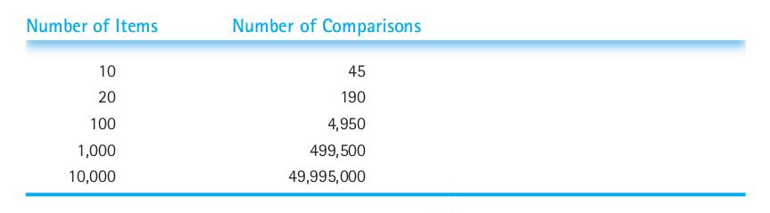
Selection sort
Analyzing the algorithm

Slide 61

Bubble Sort
Sorting algorithm

Slide 62

Bubble sort
An example problem
Arrange the following line of kids by its height (ascending), but you can only see two adjacent kids at the same time :

Slide 63
Bubble sort
The solution
Start at the left end of the line and compare the two kids in positions 0 and 1
If the one on the left is taller, you swap them
If the one on the right is taller, don’t do anything.

Slide 64
Bubble sort
The solution
Move over one position and compare the kids in position 1 and 2
Continue until you reach the right end
At this point you know the tallest kid is on the right end. As the algorithm progresses the biggest items “bubbles up” to the end of the array

Slide 65
Bubble sort
The solution
In the first pass you did N-1 comparisons.
Do a second pass but stopping on the N-2th kid, because you know the last kid is the tallest.
Continue until all kids are sorted

Slide 66
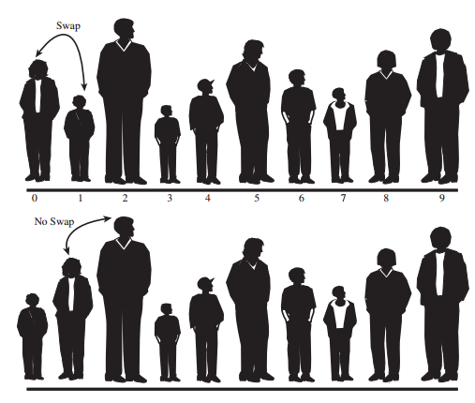
Bubble sort
The solution

Slide 67
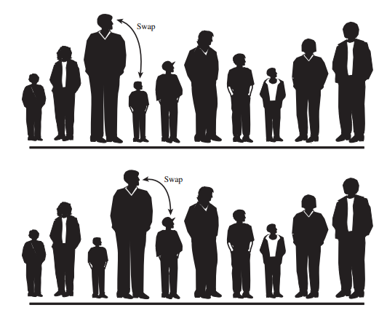
Bubble sort
The solution

Slide 68
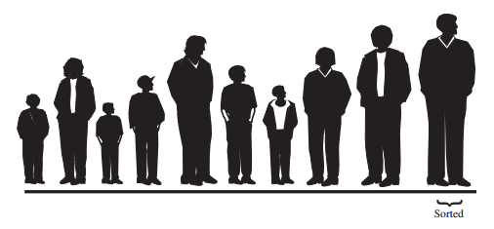
Bubble sort
The solution
End of the first pass:

Slide 69
Bubble sort
Implementing the algorithm
01 02 03 04 05 06 07 08 09 10 11 12 | void bubbleSort() { int in; int out; for (out = nElements - 1; out > 1; out--) { for (in = 0; in < out; in++) { if (a[in] > a[in + 1]) { swap(in, in + 1); } } } }

Slide 70
Bubble sort
Analyzing the algorithm
It is the same as selection sort
O(N²)

Slide 71
Insertion Sort
Sorting algorithm

Slide 72
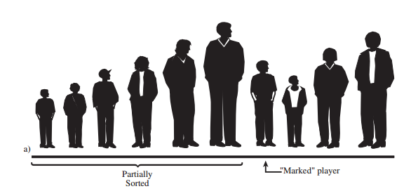
Insertion sort
An example problem
Arrange the following line of kids by its height (ascending), but the list is partially sorted :

Slide 73
Insertion sort
An example problem
Arrange the following line of kids by its height (ascending), but the list is partially sorted :
No, it is not necessary for the list to be partially sorted from the beginning

Slide 74
Insertion sort
The solution
Take the first kid from the unsorted part of the list. (If we are beginning, the sorted part will be comprised by the first element of the list)
We need to insert the selected kid into the appropriate place in the sorted group

Slide 75
Insertion sort
The solution
To do this, we’ll need to shift some of the sorted kids to the right to make room
Remove the selected kid
Shift the sorted kids: the tallest kid moved to the removed kid spot, and the next into the tallest kid spot, and so on…
The shifting stops when you’ve shifted the last kid that’s taller than the marked kid.

Slide 76
Insertion sort
The solution
The process is repeated until all the unsorted kids have been inserted (insertion sort) into the appropriate place in the partially sorted group

Slide 77
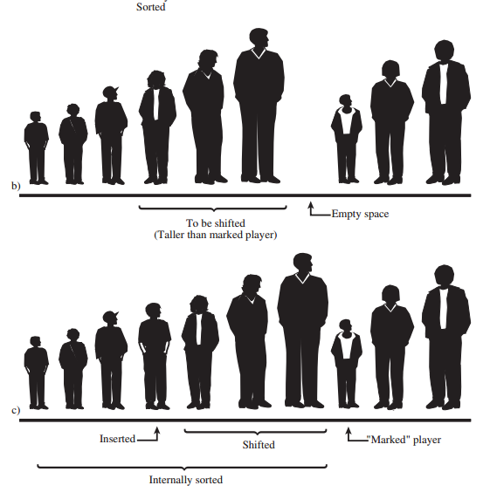
Insertion sort
The solution

Slide 78
Insertion sort
Implementing the algorithm
01 02 03 04 05 06 07 08 09 10 11 12 13 14 | void insertionSort() { int in; int out; for (out = 1; out < nElems; out++) { long temp = a[out]; in = out; while (in > 0 && a[in-1] >= temp) { a[in] = a[in-1]; --in; } a[in] = temp; } }

Slide 79
Insertion sort
Analyzing the algorithm
It is the same as selection sort and bubble sort
O(N²)

Slide 80
Shell Sort
Sorting algorithm

Slide 81
Shell Sort
Discovered by Donald L. Shell in 1959
Based on insertion sort, but adds a new feature that dramatically improves its performance
Good for medium-sized arrays (up to a few thousand items)

Slide 82
Shell Sort
Discovered by Donald L. Shell in 1959
Based on insertion sort, but adds a new feature that dramatically improves its performance
Good for medium-sized arrays (up to a few thousand items)

Slide 83
Shell Sort
Breaks the original list in sublists, each of which is sorted using insertion sort
Instead of breaking the list into sublists of contiguous elements, the shell uses an increment h, called the gap, creating a list that is h elements apart.

Slide 84
Shell Sort
Example problem
Sort the following array:
14 | 7 | 3 | 12 | 9 | 11 | 6 | 2
Define an h...
h = 1;
while(h <= nElems/3)
h = h*3 + 1;

Slide 85
Shell Sort
The solution
0 | 1 | 2 | 3 | 4 | 5 | 6 | 7
14 | 7 | 3 | 12 | 9 | 11 | 6 | 2

Slide 86
Shell Sort
The solution
0 | 1 | 2 | 3 | 4 | 5 | 6 | 7
9 | 7 | 3 | 12 | 14 | 11 | 6 | 2

Slide 87
Shell Sort
The solution
0 | 1 | 2 | 3 | 4 | 5 | 6 | 7
9 | 7 | 3 | 12 | 14 | 11 | 6 | 2

Slide 88
Shell Sort
The solution
0 | 1 | 2 | 3 | 4 | 5 | 6 | 7
9 | 7 | 3 | 12 | 14 | 11 | 6 | 2

Slide 89
Shell Sort
The solution
0 | 1 | 2 | 3 | 4 | 5 | 6 | 7
9 | 7 | 3 | 12 | 14 | 11 | 6 | 2

Slide 90
Shell Sort
The solution
0 | 1 | 2 | 3 | 4 | 5 | 6 | 7
9 | 7 | 3 | 2 | 14 | 11 | 6 | 12

Slide 91
Shell Sort
The solution
0 | 1 | 2 | 3 | 4 | 5 | 6 | 7
9 | 7 | 3 | 2 | 14 | 11 | 6 | 12

Slide 92
Shell Sort
The solution
0 | 1 | 2 | 3 | 4 | 5 | 6 | 7
7 | 9 | 3 | 2 | 14 | 11 | 6 | 12

Slide 93
Shell Sort
The solution
0 | 1 | 2 | 3 | 4 | 5 | 6 | 7
7 | 9 | 3 | 2 | 14 | 11 | 6 | 12

Slide 94
Shell Sort
The solution
0 | 1 | 2 | 3 | 4 | 5 | 6 | 7
7 | 3 | 9 | 2 | 14 | 11 | 6 | 12

Slide 95
Shell Sort
The solution
0 | 1 | 2 | 3 | 4 | 5 | 6 | 7
7 | 3 | 9 | 2 | 14 | 11 | 6 | 12

Slide 96
Shell Sort
The solution
0 | 1 | 2 | 3 | 4 | 5 | 6 | 7
3 | 7 | 9 | 2 | 14 | 11 | 6 | 12

Slide 97
Shell Sort
The solution
0 | 1 | 2 | 3 | 4 | 5 | 6 | 7
3 | 7 | 9 | 2 | 14 | 11 | 6 | 12

Slide 98
Shell Sort
The solution
0 | 1 | 2 | 3 | 4 | 5 | 6 | 7
3 | 7 | 2 | 9 | 14 | 11 | 6 | 12

Slide 99
Shell Sort
The solution
0 | 1 | 2 | 3 | 4 | 5 | 6 | 7
3 | 7 | 2 | 9 | 14 | 11 | 6 | 12

Slide 100
Shell Sort
The solution
0 | 1 | 2 | 3 | 4 | 5 | 6 | 7
3 | 2 | 7 | 9 | 14 | 11 | 6 | 12

Slide 101
Shell Sort
The solution
0 | 1 | 2 | 3 | 4 | 5 | 6 | 7
3 | 2 | 7 | 9 | 14 | 11 | 6 | 12

Slide 102
Shell Sort
The solution
0 | 1 | 2 | 3 | 4 | 5 | 6 | 7
2 | 3 | 7 | 9 | 14 | 11 | 6 | 12

Slide 103
Shell Sort
The solution
0 | 1 | 2 | 3 | 4 | 5 | 6 | 7
2 | 3 | 7 | 9 | 14 | 11 | 6 | 12

Slide 104
Shell Sort
The solution
0 | 1 | 2 | 3 | 4 | 5 | 6 | 7
2 | 3 | 7 | 9 | 14 | 11 | 6 | 12

Slide 105
Shell Sort
The solution
0 | 1 | 2 | 3 | 4 | 5 | 6 | 7
2 | 3 | 7 | 9 | 11 | 14 | 6 | 12

Slide 106
Shell Sort
The solution
0 | 1 | 2 | 3 | 4 | 5 | 6 | 7
2 | 3 | 7 | 9 | 11 | 14 | 6 | 12

Slide 107
Shell Sort
The solution
0 | 1 | 2 | 3 | 4 | 5 | 6 | 7
2 | 3 | 7 | 9 | 11 | 14 | 6 | 12

Slide 108
Shell Sort
The solution
0 | 1 | 2 | 3 | 4 | 5 | 6 | 7
2 | 3 | 7 | 9 | 11 | 6 | 14 | 12

Slide 109
Shell Sort
The solution
0 | 1 | 2 | 3 | 4 | 5 | 6 | 7
2 | 3 | 7 | 9 | 11 | 6 | 14 | 12

Slide 110
Shell Sort
The solution
0 | 1 | 2 | 3 | 4 | 5 | 6 | 7
2 | 3 | 7 | 9 | 6 | 11 | 14 | 12

Slide 111
Shell Sort
The solution
0 | 1 | 2 | 3 | 4 | 5 | 6 | 7
2 | 3 | 7 | 9 | 6 | 11 | 14 | 12

Slide 112
Shell Sort
The solution
0 | 1 | 2 | 3 | 4 | 5 | 6 | 7
2 | 3 | 7 | 6 | 9 | 11 | 14 | 12

Slide 113
Shell Sort
The solution
0 | 1 | 2 | 3 | 4 | 5 | 6 | 7
2 | 3 | 7 | 6 | 9 | 11 | 14 | 12

Slide 114
Shell Sort
The solution
0 | 1 | 2 | 3 | 4 | 5 | 6 | 7
2 | 3 | 6 | 7 | 9 | 11 | 14 | 12

Slide 115
Shell Sort
The solution
0 | 1 | 2 | 3 | 4 | 5 | 6 | 7
2 | 3 | 6 | 7 | 9 | 11 | 14 | 12

Slide 116
Shell Sort
The solution
0 | 1 | 2 | 3 | 4 | 5 | 6 | 7
2 | 3 | 6 | 7 | 9 | 11 | 14 | 12

Slide 117
Shell Sort
The solution
0 | 1 | 2 | 3 | 4 | 5 | 6 | 7
2 | 3 | 6 | 7 | 9 | 11 | 12 | 14

Slide 118
Shell Sort
The solution
0 | 1 | 2 | 3 | 4 | 5 | 6 | 7
2 | 3 | 6 | 7 | 9 | 11 | 12 | 14

Slide 119
Shell Sort
Implementing the algorithm
01 02 03 04 05 06 07 08 09 10 11 12 13 14 15 16 17 | public static void sort(Comparable[] a) { int N = a.length; // 3x+1 increment sequence: 1, 4, 13, 40, 121, 364, 1093, int h = 1; while (h < N/3) h = 3*h + 1; while (h >= 1) { // h-sort the array for (int i = h; i < N; i++) { for (int j = i; j >= h && a[j] < a[j-h]; j -= h) { swap(a, j, j-h); } } h /= 3; } }

Slide 120
Shell Sort
Analyzing the algorithm
Picking the right gap is not standard
Different sequences can do the job
No one so far has been able to analyze the efficiency theoretically
Based on experiments, there are various estimates

Slide 121
Shell Sort
Analyzing the algorithm
Picking the right gap is not standard
Different sequences can do the job
No one so far has been able to analyze the efficiency theoretically
Based on experiments, there are various estimates

Slide 122
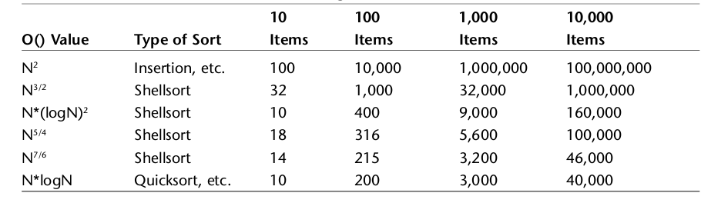
Shell Sort
Analyzing the algorithm

Slide 123
Merge Sort
Sorting algorithm

Slide 124
Merge Sort
Example problem
Sort the following array:
14 | 7 | 3 | 12 | 9 | 11 | 6 | 2

Slide 125
Merge Sort
The solution
Cut the array in half
MergeSort the left half
MergeSort the right half
Merge the sorted halves into one sorted array

Slide 126
Merge Sort
The solution
14 | 7 | 3 | 12 | 9 | 11 | 6 | 2
14 | 7 | 3 | 12
9 | 11 | 6 | 2

Slide 127
Merge Sort
The solution
14 | 7 | 3 | 12 | 9 | 11 | 6 | 2
14 | 7 | 3 | 12
9 | 11 | 6 | 2
14 | 7
3 | 12
9 | 11
6 | 2

Slide 128
Merge Sort
The solution
14 | 7 | 3 | 12 | 9 | 11 | 6 | 2
14 | 7 | 3 | 12
9 | 11 | 6 | 2
14 | 7
3 | 12
9 | 11
6 | 2
14
7
3
12
9
11
6
2

Slide 129
Merge Sort
The solution
14
7
3
12
9
11
6
2

Slide 130
Merge Sort
The solution
14
7
3
12
9
11
6
2
7 | 14
3 | 12
9 | 11
2 | 6

Slide 131
Merge Sort
The solution
14
7
3
12
9
11
6
2
7 | 14
3 | 12
9 | 11
2 | 6
3 | 7 | 12 | 14
2 | 6 | 9 | 11

Slide 132
Merge Sort
The solution
14
7
3
12
9
11
6
2
7 | 14
3 | 12
9 | 11
2 | 6
3 | 7 | 12 | 14
2 | 6 | 9 | 11
2 | 3 | 6 | 7 | 9 | 11 | 12 | 14

Slide 133
Merge Sort
Implementing the algorithm
01 02 03 04 05 06 07 08 09 10 | void mergeSort(int[] a, int low, int high) { int mid; if (low < high) { mid = (low + high) / 2; mergesort(a, low, mid); mergesort(a, mid + 1, high); merge(a, low, high, mid); } return; }

Slide 134
Merge Sort
Implementing the algorithm
01 02 03 04 05 06 07 08 09 10 11 12 13 14 15 16 | void merge(int[] a, int low, int high, int mid) { int i, j, k, c[50]; i = low; k = low; j = mid + 1; while (i <= mid && j <= high) { if (a[i] < a[j]) { c[k] = a[i]; k++; i++; } else { c[k] = a[j]; k++; j++; } }

Slide 135
Merge Sort
Implementing the algorithm
01 02 03 04 05 06 07 08 09 10 11 12 13 14 | while (i <= mid) { c[k] = a[i]; k++; i++; } while (j <= high) { c[k] = a[j]; k++; j++; } for (i = low; i < k; i++) { a[i] = c[i]; } }

Slide 136
Merge Sort
Analyzing the algorithm
Splits the original array into two halves
Sorts the first half of the array using the divide and conquer approach
Sort the second half using the same approach
Merges the two halves

Slide 137
Merge Sort
Analyzing the algorithm
Merge sort continuously divides the original array in two until it has created N one element subarrays
To divide the array O(N) is required and merging each level is also O(N)
How many levels are generated? log₂N

Slide 138
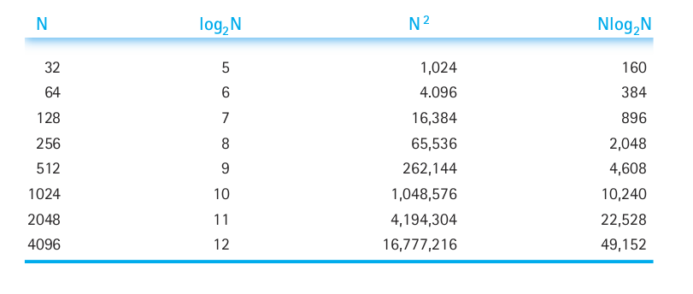
Merge Sort
Analyzing the algorithm
So merge sort is O(Nlog₂N)

Slide 139
Quick Sort
Sorting algorithm

Slide 140
Quicksort
Is the most popular sorting algorithm
In the majority of situations is the fastest (for in memory sorting)
Works by partitioning an array into two subarrays and then calling itself recursively to quick-sort each of these subarrays

Slide 141
QuickSort
Example problem
Sort the following array:
14 | 7 | 3 | 12 | 9 | 11 | 6 | 2

Slide 142
QuickSort
The solution
0 | 1 | 2 | 3 | 4 | 5 | 6 | 7
14 | 7 | 3 | 12 | 9 | 11 | 6 | 2

Slide 143
QuickSort
The solution
0 | 1 | 2 | 3 | 4 | 5 | 6 | 7
14 | 7 | 3 | 12 | 9 | 11 | 6 | 2
Let's calculate the pivot
0 + ((7- 0) / 2) = 3

Slide 144
QuickSort
The solution
0 | 1 | 2 | 3 | 4 | 5 | 6 | 7
14 | 7 | 3 | 12 | 9 | 11 | 6 | 2

Slide 145
QuickSort
The solution
Is less than the pivot?
Is greater than the pivot?
0 | 1 | 2 | 3 | 4 | 5 | 6 | 7
14 | 7 | 3 | 12 | 9 | 11 | 6 | 2

Slide 146
QuickSort
The solution
Swap!
Swap!
0 | 1 | 2 | 3 | 4 | 5 | 6 | 7
14 | 7 | 3 | 12 | 9 | 11 | 6 | 2

Slide 147
QuickSort
The solution
Is less than the pivot?
0 | 1 | 2 | 3 | 4 | 5 | 6 | 7
2 | 7 | 3 | 12 | 9 | 11 | 6 | 14

Slide 148
QuickSort
The solution
Is less than the pivot?
0 | 1 | 2 | 3 | 4 | 5 | 6 | 7
2 | 7 | 3 | 12 | 9 | 11 | 6 | 14

Slide 149
QuickSort
The solution
Is greater than the pivot?
0 | 1 | 2 | 3 | 4 | 5 | 6 | 7
2 | 7 | 3 | 12 | 9 | 11 | 6 | 14

Slide 150
QuickSort
The solution
Swap!
0 | 1 | 2 | 3 | 4 | 5 | 6 | 7
2 | 7 | 3 | 12 | 9 | 11 | 6 | 14

Slide 151
QuickSort
The solution
Is less than the pivot?
0 | 1 | 2 | 3 | 4 | 5 | 6 | 7
2 | 7 | 3 | 6 | 9 | 11 | 12 | 14

Slide 152
QuickSort
The solution
Is less than the pivot?
0 | 1 | 2 | 3 | 4 | 5 | 6 | 7
2 | 7 | 3 | 6 | 9 | 11 | 12 | 14

Slide 153
QuickSort
The solution
0 | 1 | 2 | 3 | 4 | 5 | 6 | 7
2 | 7 | 3 | 6 | 9 | 11 | 12 | 14

Slide 154
QuickSort
The solution
Recurse!
0 | 1 | 2 | 3 | 4 | 5 | 6 | 7
2 | 7 | 3 | 6 | 9 | 11 | 12 | 14

Slide 155
QuickSort
The solution
0 | 1 | 2 | 3 | 4 | 5 | 6 | 7
2 | 7 | 3 | 6 | 9 | 11 | 12 | 14

Slide 156
QuickSort
The solution
0 | 1 | 2 | 3 | 4 | 5 | 6 | 7
2 | 7 | 3 | 6 | 9 | 11 | 12 | 14

Slide 157
QuickSort
The solution
0 | 1 | 2 | 3 | 4 | 5 | 6 | 7
2 | 3 | 7 | 6 | 9 | 11 | 12 | 14

Slide 158
QuickSort
The solution
Recurse!
0 | 1 | 2 | 3 | 4 | 5 | 6 | 7
2 | 3 | 7 | 6 | 9 | 11 | 12 | 14

Slide 159
QuickSort
The solution
0 | 1 | 2 | 3 | 4 | 5 | 6 | 7
2 | 3 | 7 | 6 | 9 | 11 | 12 | 14

Slide 160
QuickSort
The solution
0 | 1 | 2 | 3 | 4 | 5 | 6 | 7
2 | 3 | 7 | 6 | 9 | 11 | 12 | 14

Slide 161
QuickSort
The solution
0 | 1 | 2 | 3 | 4 | 5 | 6 | 7
2 | 3 | 7 | 6 | 9 | 11 | 12 | 14

Slide 162
QuickSort
The solution
0 | 1 | 2 | 3 | 4 | 5 | 6 | 7
2 | 3 | 6 | 7 | 9 | 11 | 12 | 14

Slide 163
Quicksort
Implementing the algorithm
01 02 03 04 05 06 07 08 09 10 11 12 13 | public class Quicksort { private int[] numbers; private int number; public void sort(int[] values) { // check for empty or null array if (values ==null || values.length==0){ return; } this.numbers = values; number = values.length; quicksort(0, number - 1); }

Slide 164
Quicksort
Implementing the algorithm
01 02 03 04 05 06 07 08 09 10 11 12 13 14 15 16 17 | private void quicksort(int low, int high) { int i = low, j = high; int pivot = numbers[low + (high - low) / 2]; while (i <= j) { while (numbers[i] < pivot) { i++; } while (numbers[j] > pivot) { j--; } if (i <= j) { exchange(i, j); i++; j--; } }

Slide 165
Quicksort
Implementing the algorithm
01 02 03 04 05 | if (low < j) quicksort(low, j); if (i < high) quicksort(i, high); }
http://me.dt.in.th/page/Quicksort/

Slide 166
Quicksort
Analyzing the algorithm
Same as MergeSort
O(Nlog₂N)

Slide 167
Radix Sort
Sorting algorithm

Slide 168
Radix Sort
Uses a different approach to the rest of algorithms
Other algorithms see the key of each element as an atomic unit
Radix sort disassembles the key into digits and arranges the data items according to the value of the digits

Slide 169
Radix Sort
Radix means the base of a system of numbers
Ten is the radix of the decimal system (base-10)
Two is the radix of the binary system (base-2)

Slide 170
Radix Sort
Example problem
Sort the following array:
170 | 45 | 75 | 90 | 802 | 24 | 2 | 66

Slide 171
Radix Sort
Example problem
170 | 45 | 75 | 90 | 802 | 24 | 2 | 66
Take the least significant digit (1s)

Slide 172
Radix Sort
The solution
0 | 1 | 2 | 3 | 4 | 5 | 6 | 7
170 | 45 | 75 | 90 | 802 | 24 | 2 | 66
0 | 1 | 2 | 3 | 4 | 5 | 6 | 7 | 8 | 9
0 | 1 | 2 | 3 | 4 | 5 | 6 | 7

Slide 173
Radix Sort
The solution
0 | 1 | 2 | 3 | 4 | 5 | 6 | 7
170 | 45 | 75 | 90 | 802 | 24 | 2 | 66
0 | 1 | 2 | 3 | 4 | 5 | 6 | 7 | 8 | 9
0 | 1 | 2 | 3 | 4 | 5 | 6 | 7

Slide 174
Radix Sort
The solution
0 | 1 | 2 | 3 | 4 | 5 | 6 | 7
170 | 45 | 75 | 90 | 802 | 24 | 2 | 66
0 | 1 | 2 | 3 | 4 | 5 | 6 | 7 | 8 | 9
2 | 0 | 2 | 0 | 1 | 2 | 1 | 0 | 0 | 0
0 | 1 | 2 | 3 | 4 | 5 | 6 | 7

Slide 175
Radix Sort
The solution
0 | 1 | 2 | 3 | 4 | 5 | 6 | 7
170 | 45 | 75 | 90 | 802 | 24 | 2 | 66
0 | 1 | 2 | 3 | 4 | 5 | 6 | 7 | 8 | 9
2 | 2 | 4 | 4 | 5 | 7 | 8 | 8 | 8 | 8
Adjust count for the output
0 | 1 | 2 | 3 | 4 | 5 | 6 | 7

Slide 176
Radix Sort
The solution
0 | 1 | 2 | 3 | 4 | 5 | 6 | 7
170 | 45 | 75 | 90 | 802 | 24 | 2 | 66
0 | 1 | 2 | 3 | 4 | 5 | 6 | 7 | 8 | 9
2 | 2 | 4 | 4 | 5 | 7 | 8 | 8 | 8 | 8
0 | 1 | 2 | 3 | 4 | 5 | 6 | 7

Slide 177
Radix Sort
The solution
0 | 1 | 2 | 3 | 4 | 5 | 6 | 7
170 | 45 | 75 | 90 | 802 | 24 | 2 | 66
0 | 1 | 2 | 3 | 4 | 5 | 6 | 7 | 8 | 9
2 | 2 | 4 | 4 | 5 | 7 | 7 | 8 | 8 | 8
0 | 1 | 2 | 3 | 4 | 5 | 6 | 7
170 | 90 | 802 | 2 | 24 | 45 | 75 | 66

Slide 178
Radix Sort
The solution
0 | 1 | 2 | 3 | 4 | 5 | 6 | 7
170 | 45 | 75 | 90 | 802 | 24 | 2 | 66
0 | 1 | 2 | 3 | 4 | 5 | 6 | 7 | 8 | 9
1 | 2 | 4 | 4 | 5 | 7 | 7 | 8 | 8 | 8
0 | 1 | 2 | 3 | 4 | 5 | 6 | 7
170 | 90 | 802 | 02 | 24 | 45 | 75 | 66
0 | 1 | 2 | 3 | 4 | 5 | 6 | 7 | 8 | 9
2 | 2 | 3 | 3 | 4 | 4 | 5 | 7 | 7 | 8
0 | 1 | 2 | 3 | 4 | 5 | 6 | 7
802 | 002 | 024 | 045 | 066 | 170 | 075 | 090
0 | 1 | 2 | 3 | 4 | 5 | 6 | 7 | 8 | 9
6 | 7 | 7 | 7 | 7 | 7 | 7 | 7 | 8 | 8
0 | 1 | 2 | 3 | 4 | 5 | 6 | 7
002 | 024 | 045 | 066 | 075 | 090 | 170 | 802

Slide 179
Radix Sort
Implementing the algorithm
01 02 03 04 05 06 07 08 09 10 11 12 13 | void radixsort(int arr[], int n) { // Find the maximum number to know number of digits int m = getMax(arr, n); // Do counting sort for every digit. // Note that instead of passing digit number, // exp is passed. exp is 10^i where i is current // digit number for (int exp = 1; m/exp > 0; exp *= 10) { countSort(arr, n, exp); } }

Slide 180
Radix Sort
Implementing the algorithm
01 02 03 04 05 06 07 08 09 10 11 12 13 | void radixsort(int arr[], int n) { // Find the maximum number to know number of digits int m = getMax(arr, n); // Do counting sort for every digit. // Note that instead of passing digit number, // exp is passed. exp is 10^i where i is current // digit number for (int exp = 1; m/exp > 0; exp *= 10) { countSort(arr, n, exp); } }

Slide 181
Radix Sort
Implementing the algorithm
01 02 03 04 05 06 07 08 09 10 11 12 13 14 15 16 17 | void countSort(int arr[], int n, int exp) { int output[n]; // output array int i, count[10] = {0}; for (i = 0; i < n; i++) count[ (arr[i]/exp)%10 ]++; for (i = 1; i < 10; i++) count[i] += count[i - 1]; for (i = n - 1; i >= 0; i--) { output[count[ (arr[i]/exp)%10 ] - 1] = arr[i]; count[ (arr[i]/exp)%10 ]--; } for (i = 0; i < n; i++) arr[i] = output[i]; }

Slide 182
Radix Sort
Analyzing the algorithm
Same as QuickSort : O(NLog₂N)
But uses twice as much memory as quickSort

Slide 183
Binary Search
Search algorithm

Slide 184
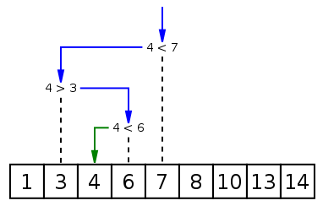
Binary Search
Finds a number in a sorted array
Compares the input element with the middle of the array.
If the input element matches, return the index to that element

Slide 185
Binary Search
Otherwise, runs the algorithm with the right or left subarray, depending if the input key is greater or less than the middle element.
Array must be sorted
O(log (N))

Slide 186
Binary Search
Implementing the algorithm
01 02 03 04 05 06 07 08 09 10 11 12 13 14 | int binarySearch(int pArray[], int pKey, int pIndexMin, int pIndexMax) { while (pIndexMax >= pIndexMin) { int middle = (int)((pIndexMax + pIndexMin) / 2); if (pArray[middle] < pkey) pIndexMin = middle + 1; else if (pArray[middle] > pKey) pIndexMax = middle - 1; else return middle; } return -1; }

Slide 187
Interpolation Search
Modification of Binary Search
In each step tries to calculate where the number might be.
Based on the idea of looking for a person in the phonebook. If you're looking for Bob, you know it should be at the beginning...
O(n)

Slide 188
Interpolation Search
Implementing the algorithm
01 02 | middle = low + ((number - array[low]) * (high - low)) / (array[high] - array[low]);

Slide 189
Interpolation Search
Implementing the algorithm
Rest of the code is equal to binary search
01 02 | middle = low + ((number - array[low]) * (high - low)) / (array[high] - array[low]);

Slide 190
Interpolation Search
Implementing the algorithm
01 02 | middle = low + ((number - array[low]) * (high - low)) / (array[high] - array[low]);
5 | 6 | 9 | 11 | 15 | 18 | 20 | 25 | 28 | 39
Let's search for 28

Slide 191
Interpolation Search
Implementing the algorithm
01 02 | middle = low + ((number - array[low]) * (high - low)) / (array[high] - array[low]);
5 | 6 | 9 | 11 | 15 | 18 | 20 | 25 | 28 | 39
The middle will be: 6

Slide 192
Interpolation Search
Implementing the algorithm
01 02 | middle = low + ((number - array[low]) * (high - low)) / (array[high] - array[low]);
5 | 6 | 9 | 11 | 15 | 18 | 20 | 25 | 28 | 39

Slide 193
Hash Search
Search algorithm

Slide 194
Hashing
f(x)
500000
222151
360951
9948570
19658
500000 9948570
222151 360951
...
...
...
...

Slide 195
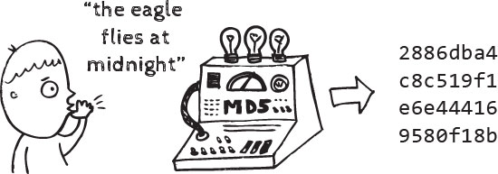
Hashing
Maps large sets of data to small sets.
It's a fast search method
Hash Function allows find and assign an index to a key value.

Slide 196
Hashing
It can map several keys to the same index
Each slot in the hash table has assigned a set of data
Each slot is called bucket

Slide 197
Hashing
Transforms keys to indexes
The basic hash function for numbers is the identity function. It is not used.
Ideal function is a bijective function or injective function. These kind of functions are not used.

Slide 198
Hash Functions
Successive substractions
What is the function?
f(x)
1998-000
1998-001
1998-002
...
1998-399
1999-000
...
yyyy-nnn
1
2
3
...
399
400
...
N

Slide 199
Hash Functions
Successive substractions
What is the function?
f(x)
1998-000
1998-001
1998-002
...
1998-399
1999-000
...
yyyy-nnn
1998000 - 1998000
1998001 - 1998000
1998002 - 1998000
...
1998399 - 1998000
(1999000 - 1998000) + 399+1
...
yyyynnn - 1998000 + (400 * (yyyy-1998))
0
1
2
...
399
400
...
N

Slide 200
Hash Functions
Modular Arithmetic
Use a prime Number
Index is the residue of divide the key between a number (module).
The number defines the amount of buckets of the hash table.

Slide 201
Hash Functions
Modular Arithmetic
f(x)
13000000
12345678
13602499
71140205
73062138
13000000 mod 13
12345678 mod 13
13602499 mod 13
71140205 mod 13
73062138 mod 13
0
7
1
6
6

Slide 202
Hash Functions
Mid-Square Method
Squares the key value
Takes the middle r digits of the result
It gives a value between 0 and ( 2^r ) -1

Slide 203
Hash Functions
Mid-Square Method
f(x)
123
136
730
301
625
123 * 123 = 15129
136 * 136 = 18496
730 * 730 = 532900
301 * 301 = 90601
625 * 625 = 390625
51
84
29
06
06

Slide 204
Hash Functions
Truncation method
Ignore part of the key and use the rest as the array index.
You don't need to get successive numbers
f(x)
13000000
12345678
13602499
71140205
73162135
13000000
12345678
13602499
71140205
73162135
100
138
169
715
715

Slide 205

Hash Functions
Folding method
Divide the key in parts
Combine this parts (might be using operator / * + -)
For example, divide a number of 8 digits in groups of 3 digits and sum this groups

Slide 206
Hash Functions
Folding method
f(x)
13000000
12345678
13602499
71140205
73162135
130 + 000 + 00 = 0130
123 + 456 + 78 = 0657
711 + 402 + 05 = 1118
136 + 024 + 99 = 0259
250 + 000 + 09 = 0259
130
657
118
259
259

Slide 207
What's the problem of hash tables?

Slide 208

Hash Functions
Collisions
Collisions are practically unavoidable
Two or more keys with the same index.
Wrong choice of hash function

Slide 209
Hash Functions
Collisions
Almost all the hash slots remaining are empty while a few are full and present a lot of collisions.
Small hash table and too much keys to be sorted.
Collisions Treatment in some cases is very expensive.

Slide 210
Selection & Ordering
Algorithms
CE-1103 Algorithms and Data Structures

